Slide 1
VA GovCloud
Introduction and Demo
April 2021
MuleSoft Team

Slide 2
GovCloud 101
Topics
What is MuleSoft GovCloud (iPaaS)? Business Groups, Environments, VPC & DLB High Level Architecture API Lifecycle in GovCloud Identity & Access Management (SSO, Roles) Design Center Exchange (Private & Public Portal) API Manager Runtime Manager Security Logging, Alerts & Analytics CI/CD in GovCloud (use internal mule setup) How to get access to GovCloud?

Slide 3
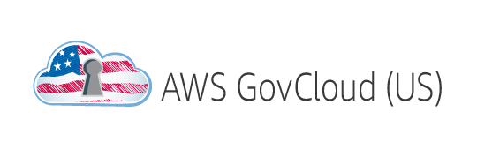


What is MuleSoft GovCloud?
MuleSoft created FedRAMP-authorized (Moderate Level) Anypoint Platform known as Government Cloud (GovCloud)
Meets the security and compliance standards set through FedRAMP
Not all capabilities and features of CloudHub Anypoint Platform are available
Built on AWS GovCloud
Supports the highest encryption standards and FIPS 140-2 compliance
Always maintain Confidentiality, Integrity & Accountability
Continuous 3rd party auditing and monitoring of security controls
Supported exclusively by US citizens
Anypoint Design Center
Anypoint Management Center
Anypoint Exchange
Unified Platform
Mule runtime engine
Anypoint Connectors
Runtime services

Slide 4
Key GovCloud Resource Inter-relationships
GovCloud
API CONSUMERS
DLB
BUSINESS GROUP
ADMIN USERS
VPC
ENVIRONMENTS
TIC
VA NETWORK

Slide 5

GovCloud Resource Breakdown
Parent Business Group (BG)
Department of VA
Child BG - Programs
RTLS
POC
DMC
VAMS
HR
VBA BIP
emPWR
VIEWS
QMS
FSC
LGP
VISN PROS
VBA COE
Dev
Dev
Dev
Dev
Dev
Dev
Dev
Dev
Dev
Dev
Dev
Test
Test
Test
Test
Test
Test
Test
Test
Test
Test
Test
Stage
Stage
Stage
Stage
Stage
Stage
Stage
Stage
Stage
Stage
Stage
Non-Prod
Prod
Prod
Prod
Prod
Prod
Prod
Prod
Prod
Prod
Prod
Prod
Prod

Slide 6
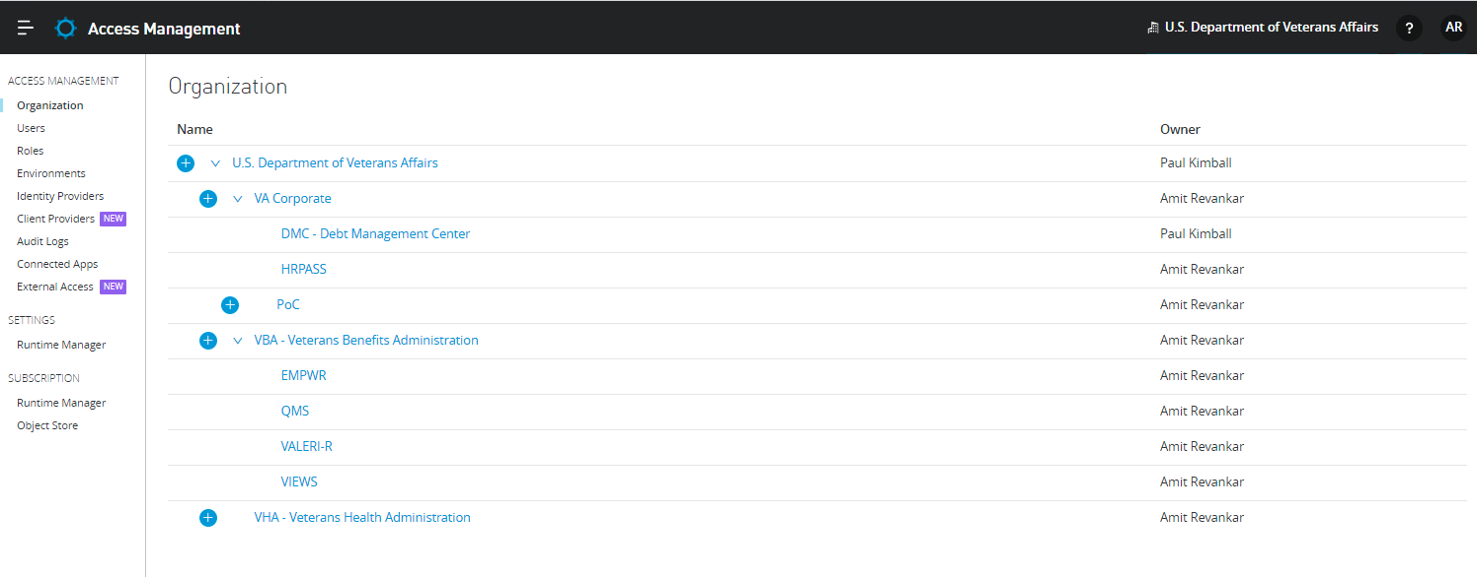
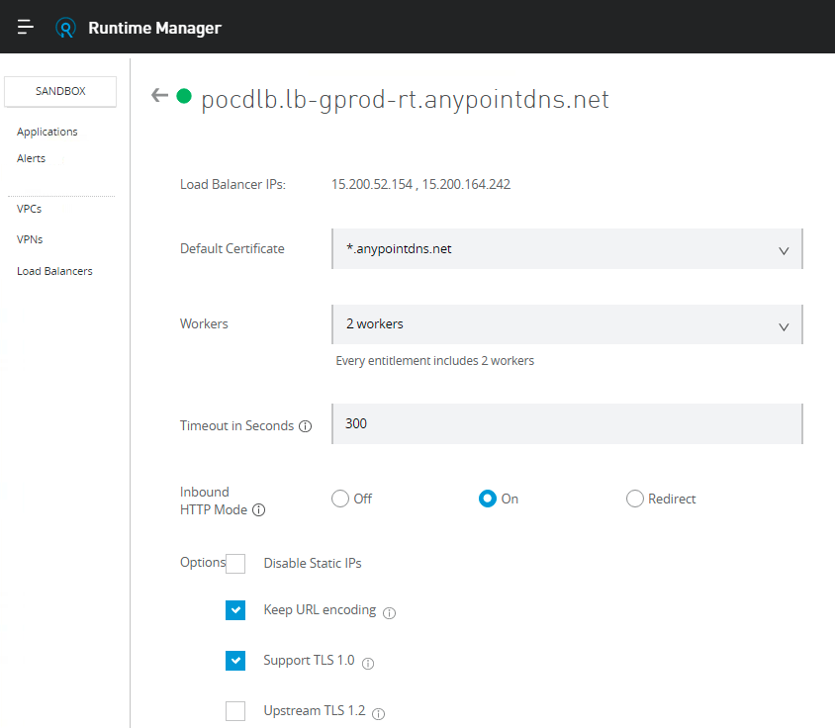
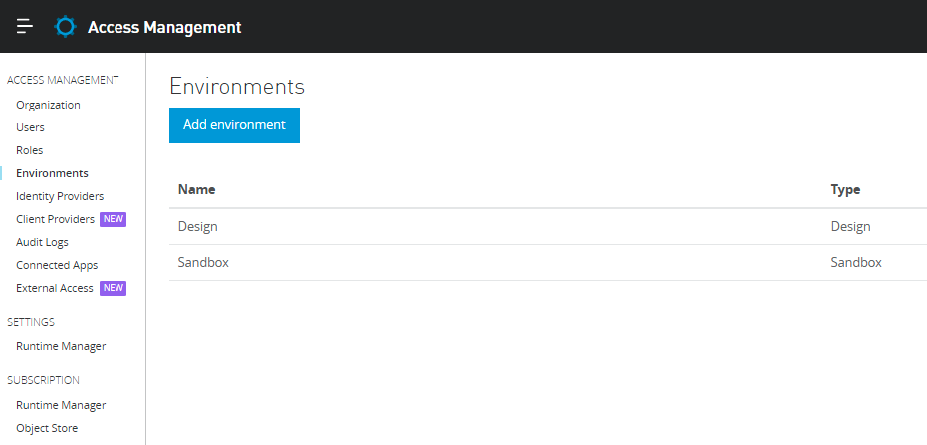
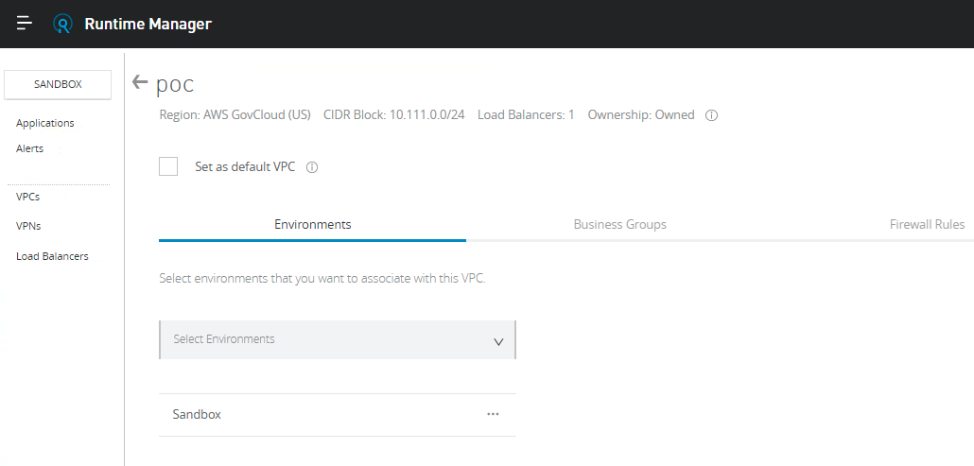
Business Groups, Environments, VPC & DLB
Dedicated Load Balancer
Business Group
Environments
VPC

Slide 7
Environments
Standard & Optional Environments
Development - Development & Unit Testing
Test - Integration Testing
Staging - CI/CD, End to End testing (pristine data set), UAT
Production-Like (Optional) - Dedicated UAT
Performance (Optional) - Stress Testing
Production - Go Live
Note: License implications need to be considered while standing up “Optional” environments
Supported Runtime Versions in GovCloud Managed Environments
3.9.1, 3.9.2, 3.9.3, 3.9.4, 4.1, 4.2, 4.3
All new development will be done on 4.x
Supported Runtime Versions in Hybrid Environments
4.3+
All new development will be done on 4.x
Supported Anypoint Studio
Runtime 4.x -> Studio 7.x

Slide 8



Anypoint Platform Deployment Flexibility
GovCloud Control Plane to manage and monitor all runtimes (APIs & Integrations) in the cloud or on-premise
Runtimes can be hosted “as a service” in MuleSoft’s FedRAMP GovCloud environment or self-managed in the VAEC or AITC
Control plane
Runtimes
Anypoint Design Center
Mule runtime engine
GovCloud - iPaaS (Mulesoft-hosted
FedRAMP Moderate)
Anypoint Management Center
Anypoint Connectors
Anypoint Exchange
Runtime services
Mule runtime engine
Anypoint Connectors
VAEC -IaaS
AWS
Runtime services
Mule runtime engine
Anypoint Connectors
VA Datacenter
AITC
Runtime services

Slide 9
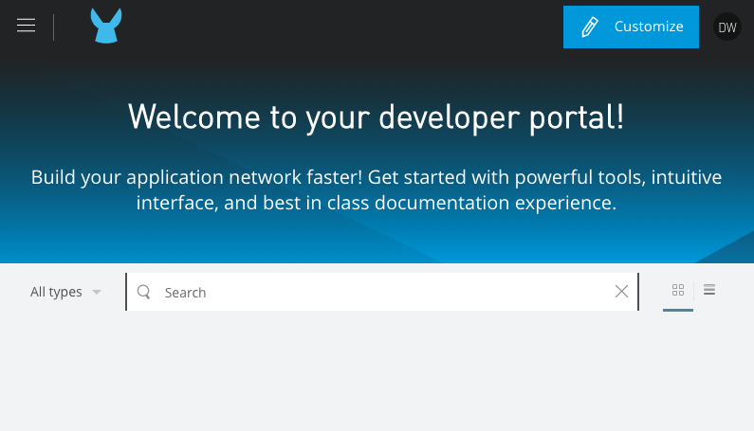
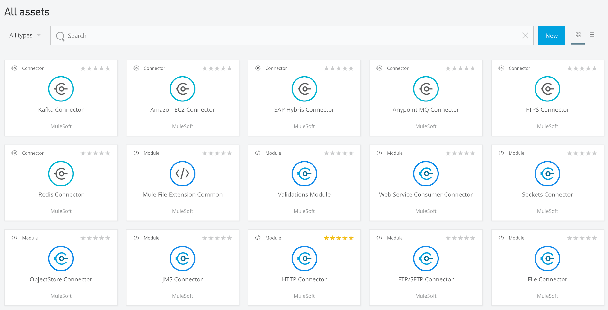
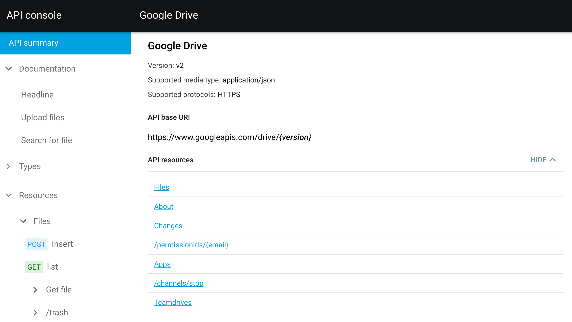

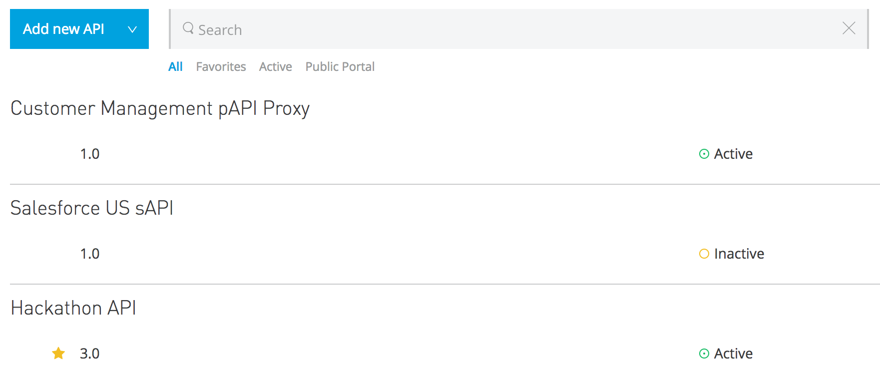
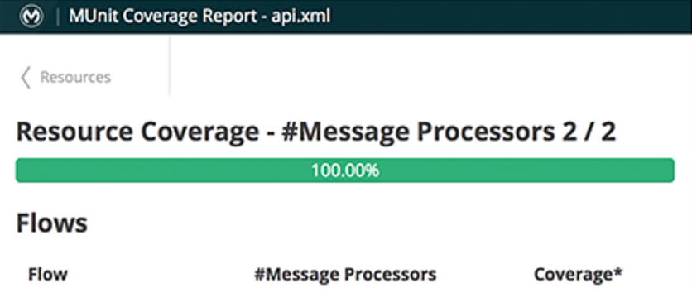
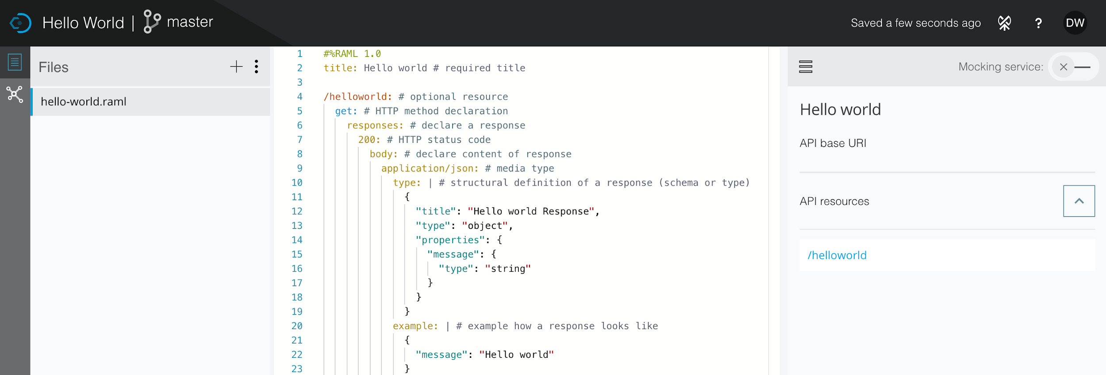
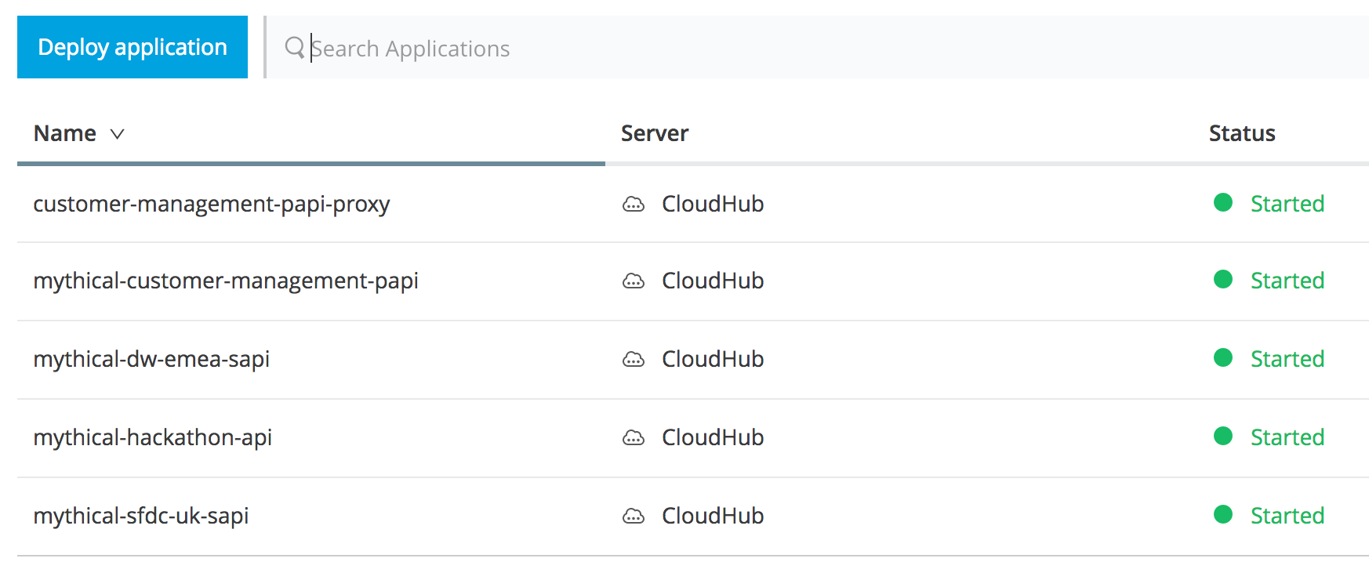
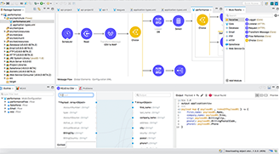
API Lifecycle in GovCloud
Developer
Developer
Developer
API Console
Anypoint Exchange Portals
Anypoint Exchange
DevOps
Developer
Developer
Operations
VALIDATE
PROTOTYPE
PUBLISH
Mocking Service
API Manager
FEEDBACK
Tester
Developer & Tester
OPERATE
DESIGN
DevOps
MUnit
Developer
Operations
Developer
API Designer
DEVELOP
Runtime Manager
DEPLOY
TEST
Anypoint Studio

Slide 10



Identity & Access Management
User Identity
Client Management
Access Control
Anypoint sign-in/up
SSO using SSOi SAML
External IDP support using OAuth 2.0 & Dynamic Client Reg.
Support for multiple IDPs
Role Based Access Control (RBAC) based
Business Groups
Environments
User and asset groups e.g. API as products
Multi-organization membership

Slide 11
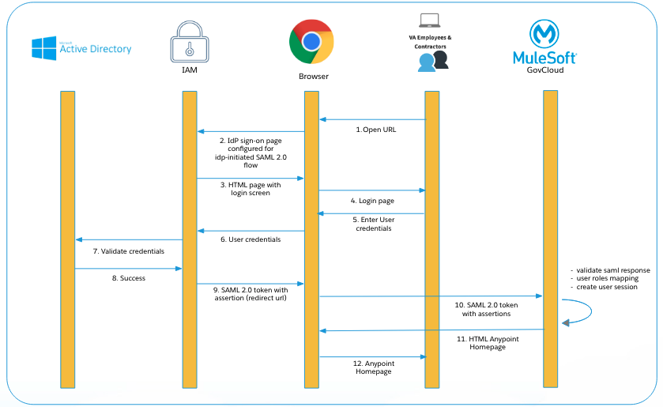
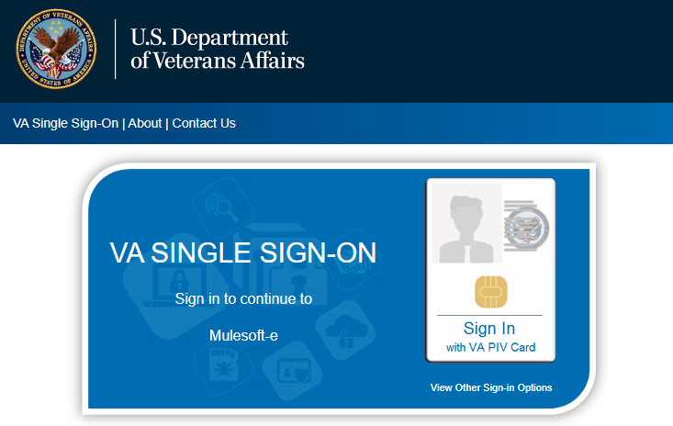
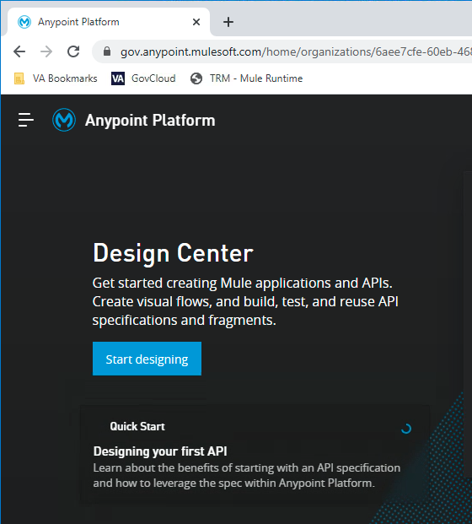
Platform User Authentication via SSOi
The platform is fully SSO enabled via SAML. All users have to use VA’s SSOi to login into the platform. Only users in VA Active Directory will be allowed into the GovCloud platform.
User Authentication Steps
User gets onto the VA Network
User then opens a VA approver web browser (Chrome, etc.)
User then open the below link
https://logon.iam.va.gov/affwebservices/public/saml2sso?SPID=us-dept-va.gov.anypoint.mulesoft.com
User will be presented with the below screen. User signs in via the SSO method.
Once authenticated, the user has now successfully logged into MuleSoft GovCloud and will be presented the screen >>>>>>>>>

Slide 12
Platform Roles Mapping to VA Roles
Platform Roles | VA Roles
API Creators | App Developer
API Versions Owner
Exchange Contributor
Exchange Viewer
Cloudhub Admin (Development)
Cloudhub Admin (Development) | App Manager Dev
Exchange Administrators
Cloudhub Admin (Testing) | App Manager Test
Exchange Administrators
Cloudhub Admin (Testing) | DevOps Manager Test
Exchange Administrators
Platform Roles | VA Roles
Cloudhub Admin (Staging) | DevOps Manager Staging
Exchange Administrators
Cloudhub Admin (Production) | DevOps Manager Prod
Exchange Administrators
Audit Log Viewers | Security Auditor
Portals Viewer | Portal Viewer
Organization Administrators | Org Admin

Slide 13
VA Roles Mapping to AD Group Names
VA Roles | AD Group Names
App Developer | VAEC_MULE_HR_AppDeveloper or MULE_DMC_AppDeveloper
App Manager Dev | VAEC_MULE_HR_AppManager_Dev or MULE_DMC_AppManager_Dev
App Manager Test | VAEC_MULE_HR_AppManager_Test or MULE_DMC_AppManager_Test
DevOps Manager Test | VAEC_MULE_HR_DevOpsManager_Test or MULE_DMC_DevOpsManager_Test
DevOps Manager Staging | VAEC_MULE_HR_DevOpsManager_Staging or MULE_DMC_DevOpsManager_Staging
DevOps Manager Prod | VAEC_MULE_HR_DevOpsManager_Prod or MULE_DMC_DevOpsManager_Prod
Security Auditor | VAEC_MULE_HR_SecAuditor or MULE_DMC_SecAuditor
Portal Viewer | VAEC_MULE_HR_PortalViewer or MULE_DMC_PortalViewer
Org Admin | VAEC_MULE_HR_OrgAdmin or MULE_DMC_OrgAdmin
AD Group Naming Conventions
For business group who has infrastructure on either AWS or Azure
<VAEC_MULE_{ProgramName}_{ROLE}>
For business group who has infrastructure on either on-premises or Mulesoft GovCloud
<MULE_{ProgramName}_{ROLE}>

Slide 14
Role Permissions
Default Roles | Permissions
API Creators | Create/Import an API
API Versions Owner | Manage any API Version in the organization Delete any API Version in the organization Deprecate any API Version in the organization Edit the Portal of any API version in the organization
Audit Log Viewers | Visualize logs in the Audit Logs section
CloudHub Admin | Create Applications Delete Applications Download Applications Manage Alerts Manage Queues Manage Schedules Manage Servers Manage Settings Read Applications Read Servers
Default Roles | Permissions
CloudHub Developer | Create Applications Download Applications Manage Alerts Manage Queues Manage Schedules Manage Settings Read Applications Read Servers
Organization Administrators | Edit developer portal theme settings Request API access terms and conditions Edit portal terms and conditions Set custom policies Manage access of third party applications to an API (Specific to the organization administrator of the Master Business Group) Edit users' email addresses Grant VPC and CloudHub dedicated load balancer permissions
Exchange Administrators | Create content Manage own content and versions Manage own reviews, including the ability to add, edit, and delete
Exchange Contributors | View and consume Exchange assets Manage own reviews, including the ability to add, edit, and delete

Slide 15
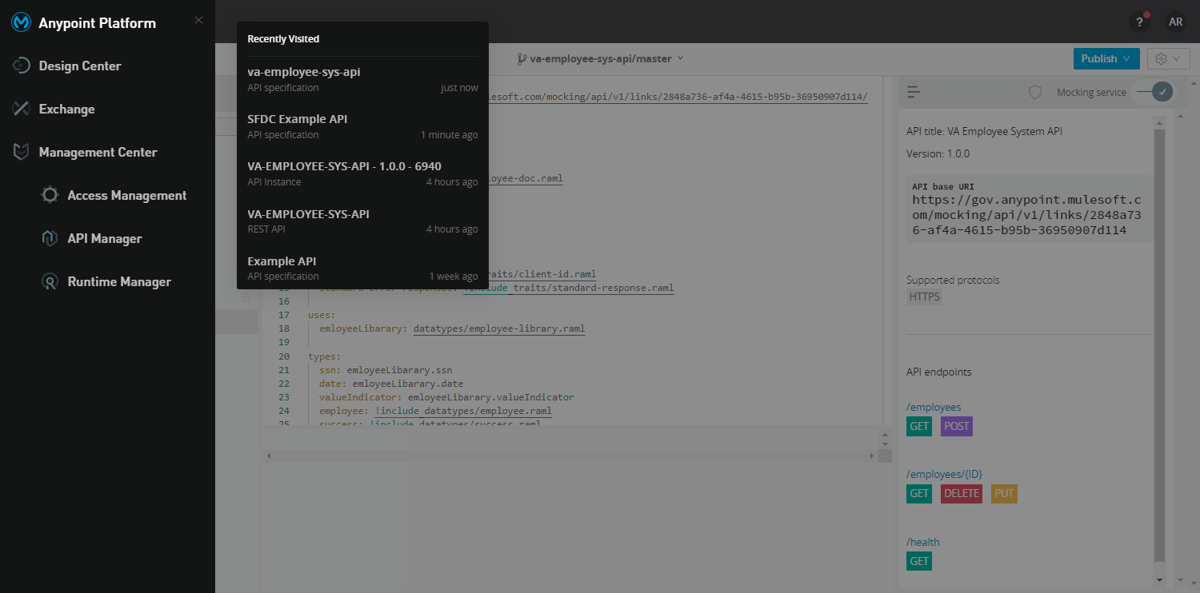
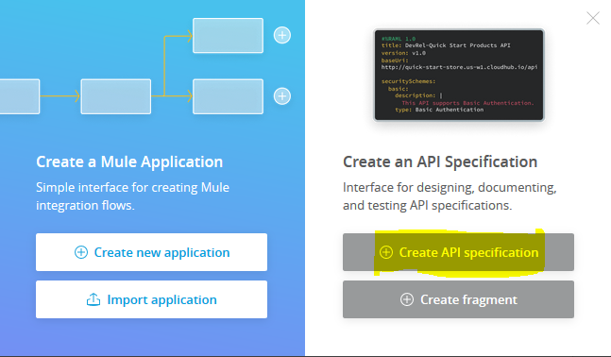
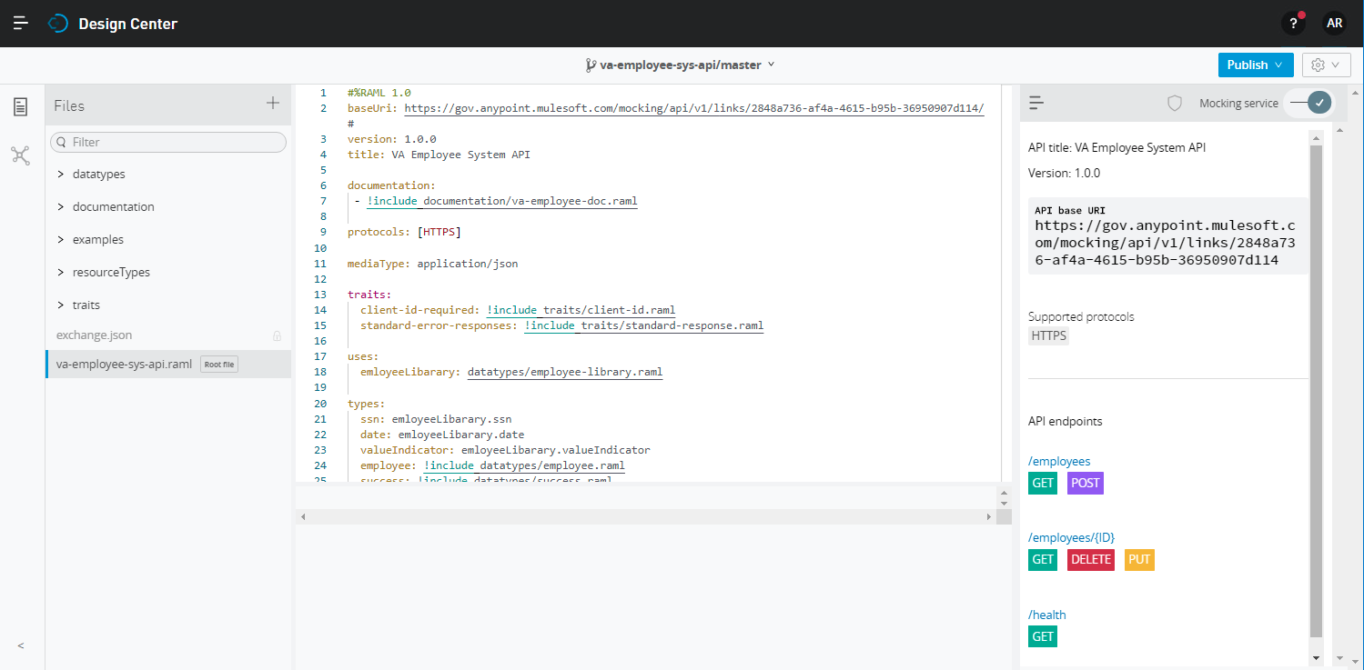
Design Center
Web based tool to design API’s REST interfaces or specifications as per the requirement
Validate the interface for any syntax error and highlight the same
Validate the interface where it show the mock interface
Provides the Mock API without any actual implementation and developer can validate request and response of the API

Slide 16
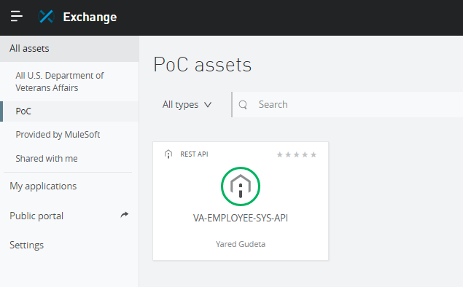
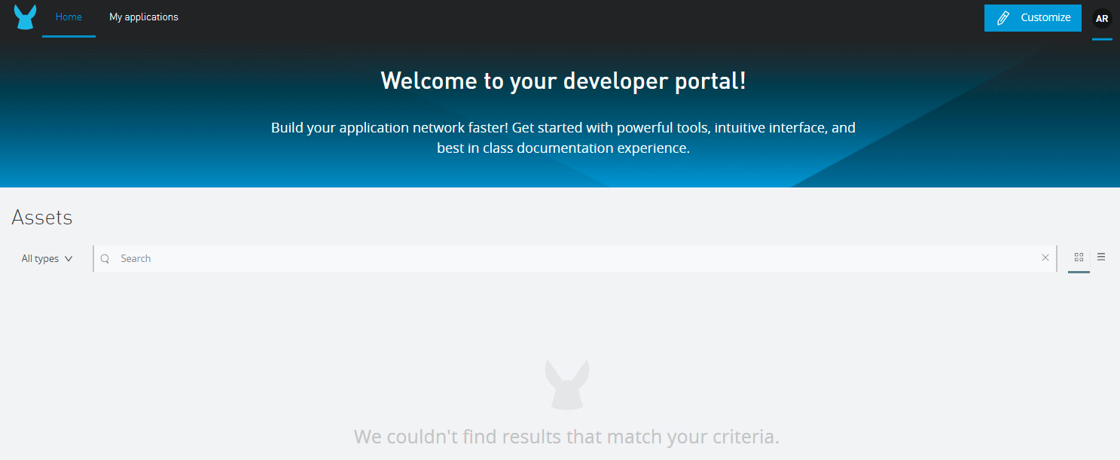
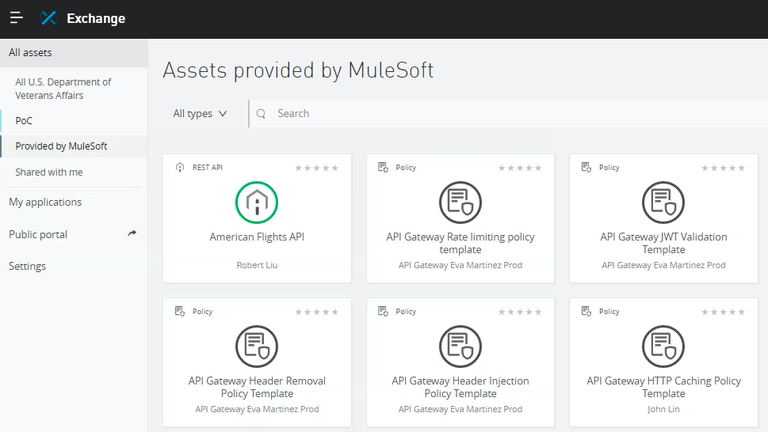
Exchange (API Catalog/Repository)
VA development teams can access API exchange for getting required APIs. Once APIs are developed in Organization then it’s published on API Exchange as Assets so that other team can utilize APIs as per their needs.
Promotes API Reusability & Standards within the organization
Provides internal and external facing portal

Slide 17
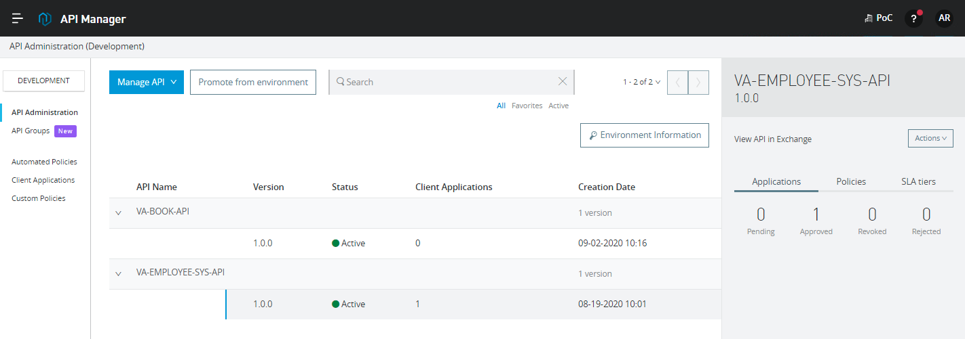
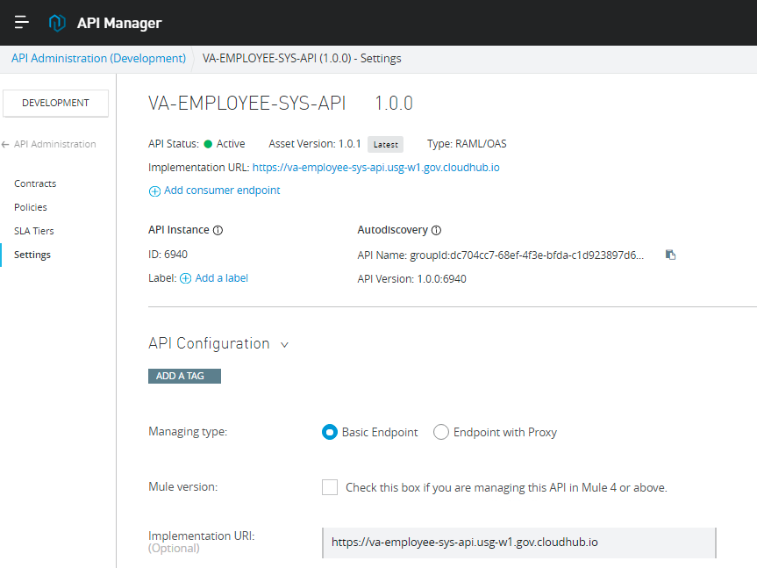
API Manager
API management tool using which VA can secure and restrict the access on APIs
Provides out of the box policies and policy creation which can be applied on different APIs

Slide 18
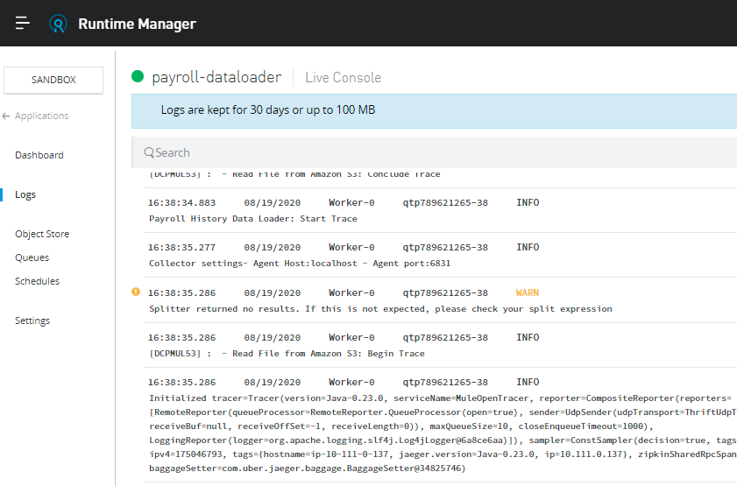
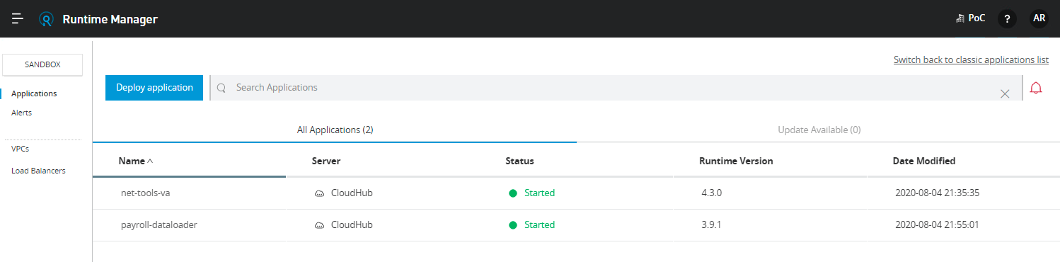
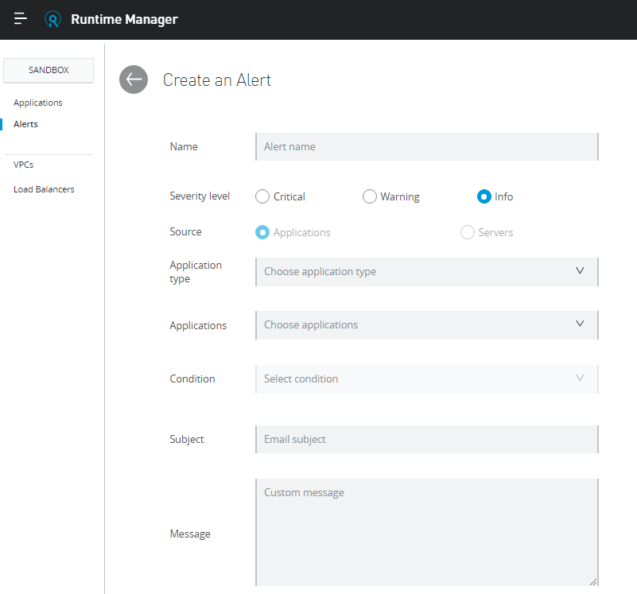
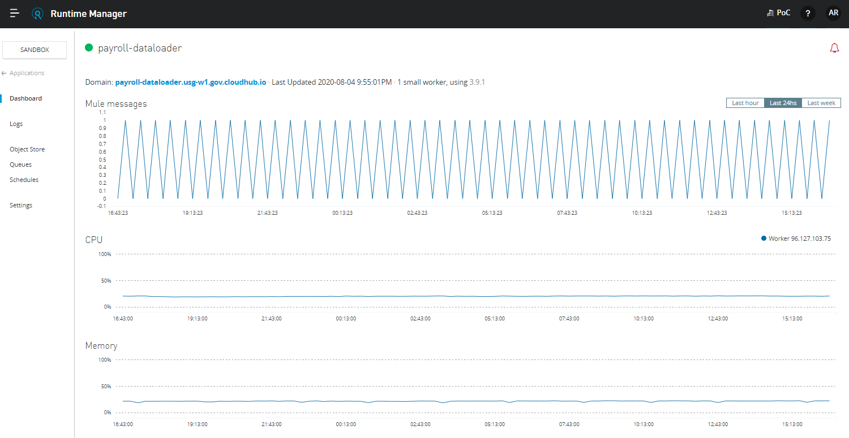
Runtime Manager
API Implementations are deployed and managed here

Slide 19
Security Measures - Logging, Alerts & Protocols
Provides a highly secure environment for government entities to perform sensitive data manipulations
Mule runtime engine transmits but does not inspect, permanently store, or otherwise interact directly with government data. Government agencies always maintain control over their data, configuration, and workers.
Integrated with VA Splunk
For all application logging & dashboards for monitoring
Built-in Alerts
Federal Information Processing Standards (FIPS 140-2) - Complies with hardware and software encryption standards for all data at rest (stored data)
Transport Layer Security (TLS) 1.2 encryption - Implements encryption for all external and internal data transmission to block “man in the middle” attacks.
NIST 800-53 - Enhances physical and logical security.
CIS benchmarks - Hardens instances to address the Center for Internet Security checklists.

Slide 20
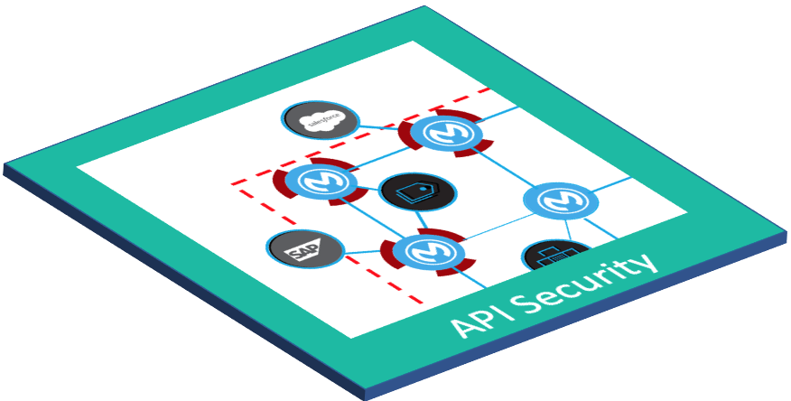
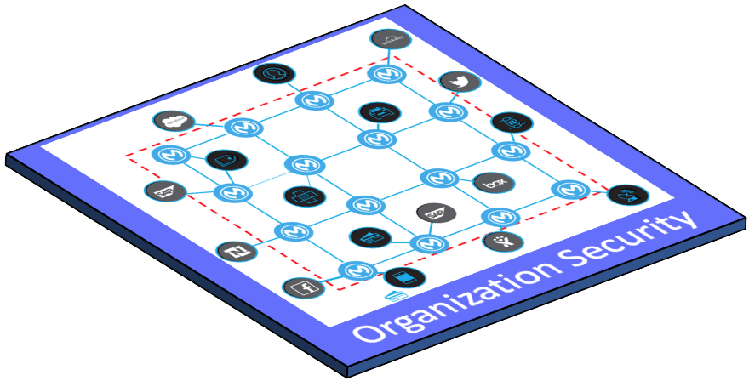
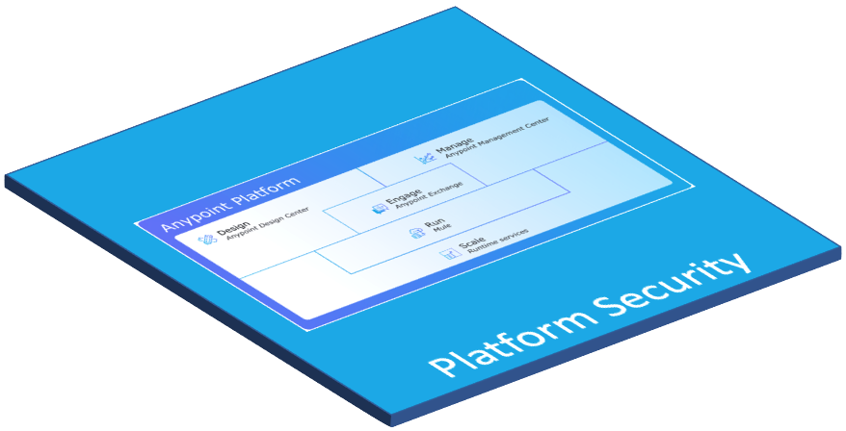
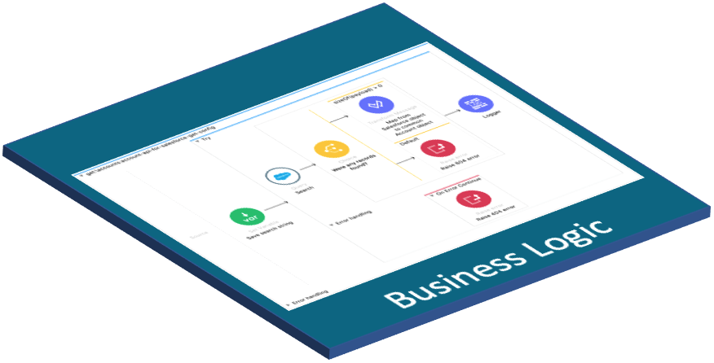
Layered Security Model
API level policies Security, QoS, Compliance, Transformation, Troubleshooting, ...
Automated policies Security, QoS, Compliance, Transformation, Troubleshooting, ...
Integrated with Identity Mgmt System
Security Scans
FIPS 140-2 Compliance (Encryption)
Response plans, etc
API implementation = “business logic”

Slide 21




How to secure an API/Service?
Simple Proxy 1:1
Complex Proxy 1:n
Embedded
API proxy
Mule API proxy Implementation
OR
API implementation
API implementation
API implementation
API implementation
Database
Database

Slide 22
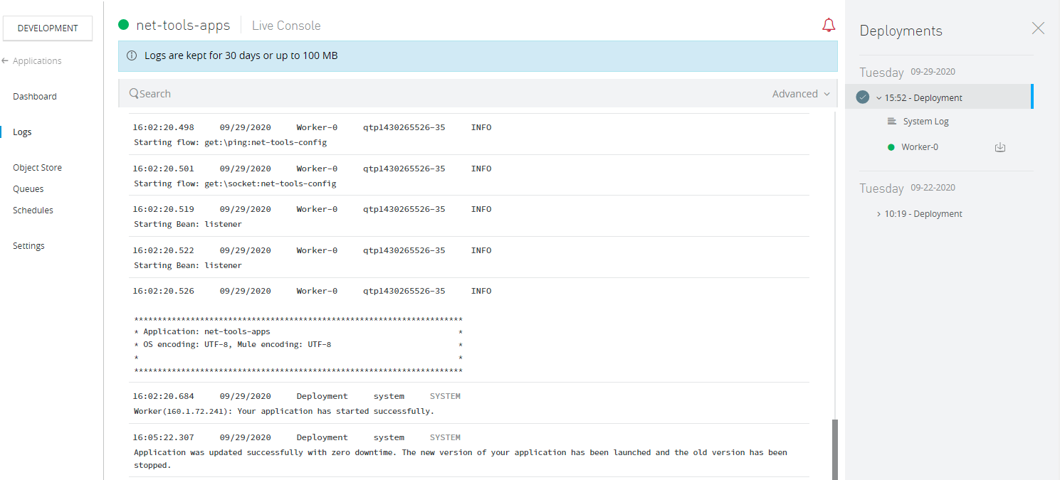
GovCloud Built-in Logs
The platform has built-in capabilities to capture logs for APIs & Integration deployed and running.
Logs are kept for 30 days or up to 100 MB
Logs are meant to help with application health
Access to logs is managed by platform roles mapped to Active Directory roles. Only few roles have access to roles. Anyone from VA with approved assignment to these role(s) will be allowed to see the logs.
Platform is integrated with VA’s Splunk

Slide 23
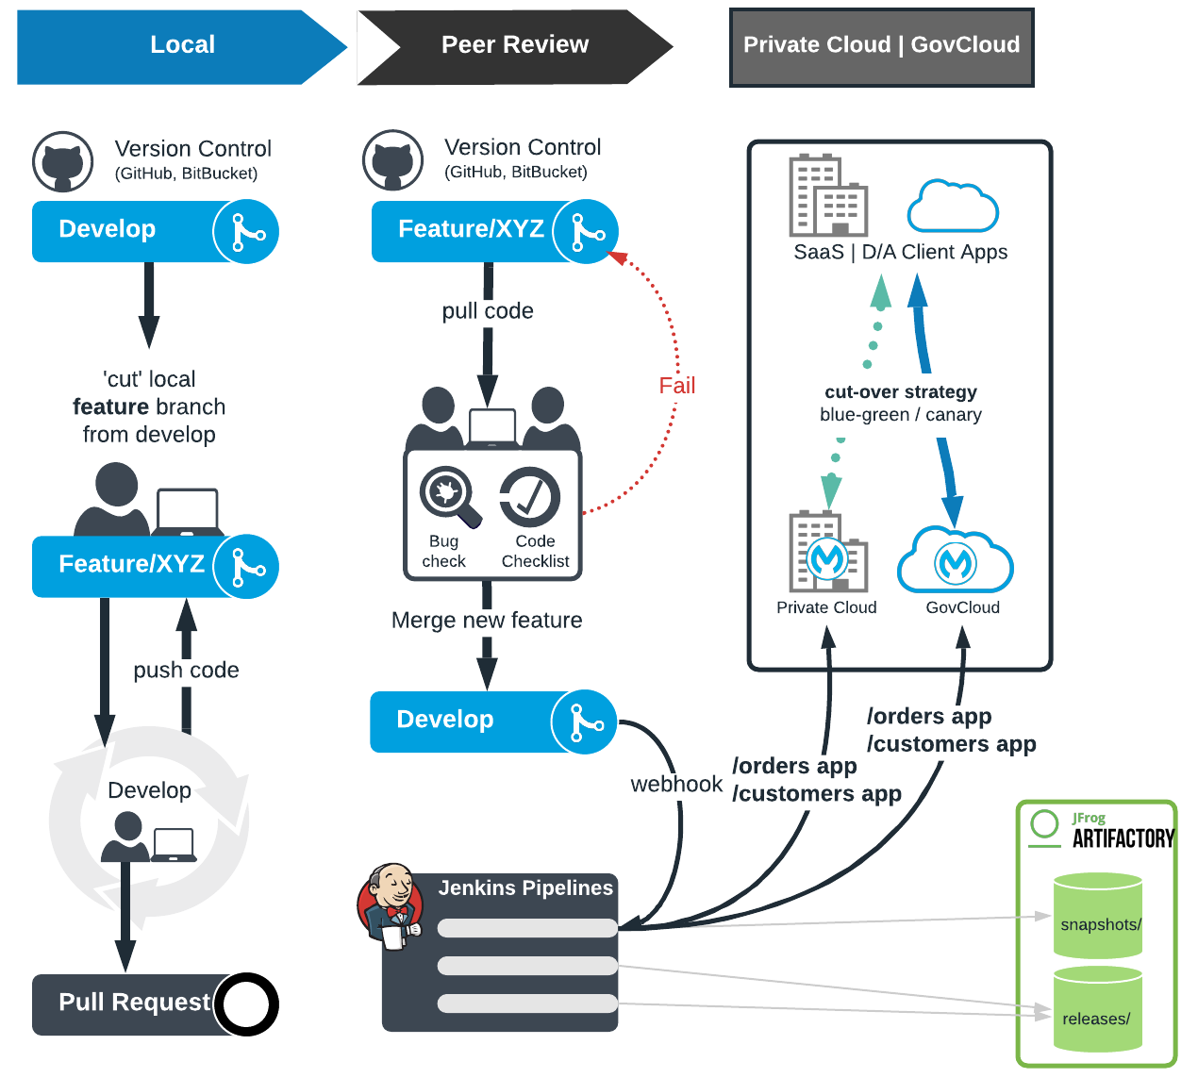
GovCloud CI/CD in collaboration with DOTS Team
Update Deployment Target
Runtime Manager (manual)
CloudHub API (scripted) + Connected Apps
CloudHub CLI (scripted) + Connected Apps
Mule-Maven Plugin + Connected Apps
Inherited via Parent POM…
Explicit in Jenkins Pipelines (maven project)
The example deployment in the diagram shows a blue-green deployment with ‘/orders’ and ‘/customers’ apps deployed to both private cloud and govcloud.

Slide 24
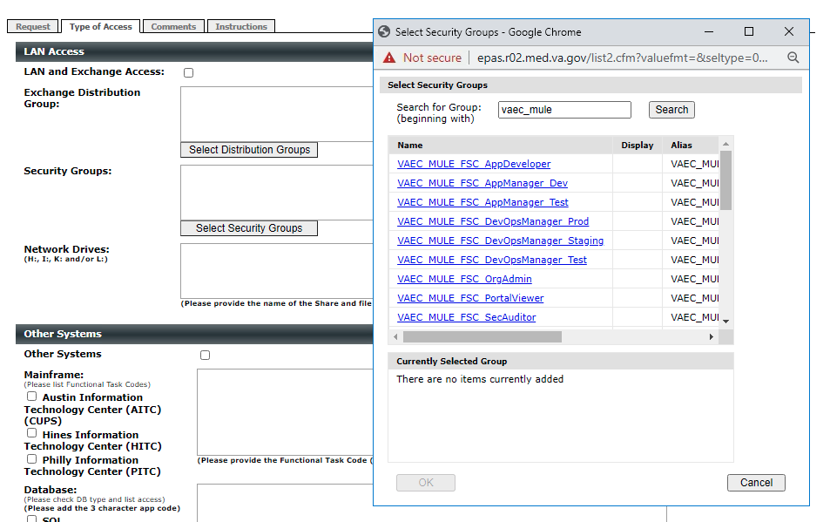
How to request access for GovCloud?
To gain access to the MuleSoft GovCloud Platform, users must complete an e9957 request form and should be designated to work on the platform. Note: Only PIV’d Individuals and VA Employees can request access to the platform.
SUBMITTING E9957
Below are the high level instructions to use the VA e9957 form for Mule GovCloud access.
Go to https://epas.r02.med.va.gov/
Select Submit New Document.
Select the template – EO – System Access Request (e9957).
Complete the e9957 Access Form for access. A contractor may complete the form. However, approvers need to be FTEs. The first approver should be your immediate supervisor. For Mule, Jerry Abernathy is the Approving Supervisor and Designated Approving Official. All requesters must have the Proof of VA Privacy and Information Security Awareness and Rules of Behavior (VA 10176) completed and up to date, and the pdf certificate available to upload to the request.
Select the Type of Access Tab then select the appropriate Mule Security groups by click on “Select Security Group” and searching for the group you need access to. Use the Security Groups as listed on “VA Roles Mapping to AD Group Names” slide.
Complete any remaining information, then Submit your request.
Retain your request details so that approval and progress tracking is possible.
Note: Detailed step-by-step instructions also available upon request.
Once added you are added to the appropriate Active Directory Security Groups, you can access Mule with your VA SSOi credentials at the following URL: https://logon.iam.va.gov/affwebservices/public/saml2sso?SPID=us-dept-va.gov.anypoint.mulesoft.com

Slide 25
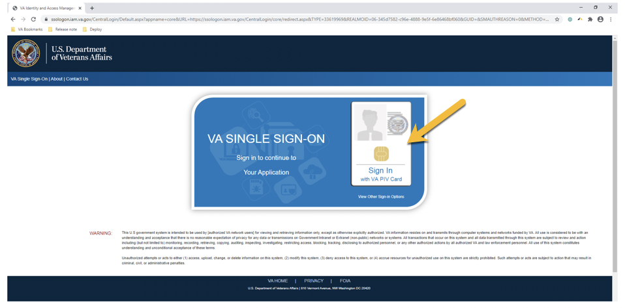
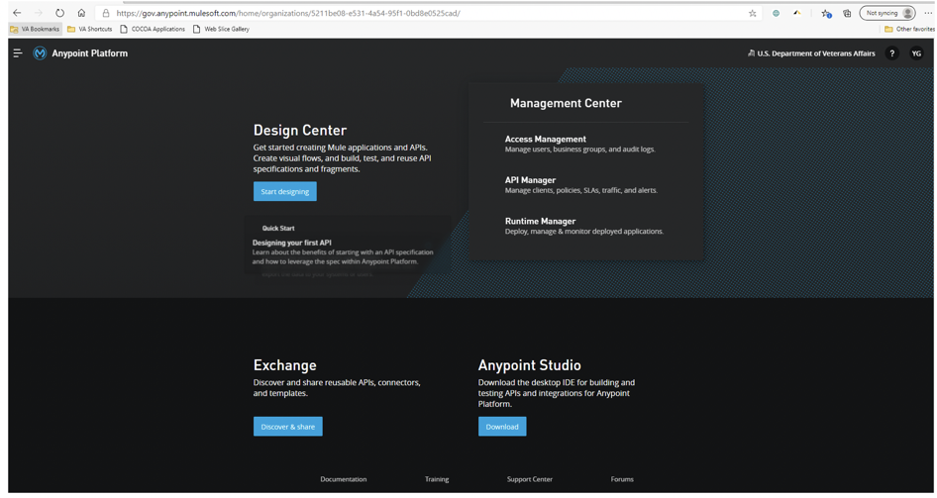
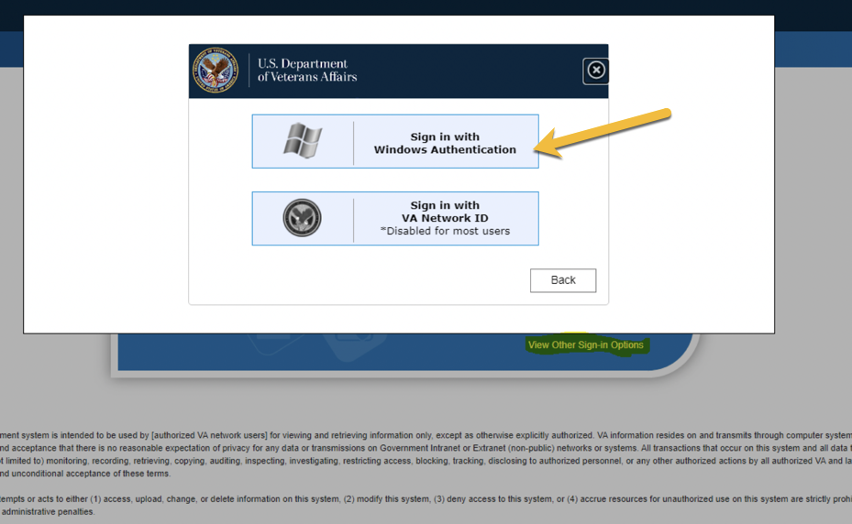
GovCloud Login Process
STEP 1
User gets onto the VA Network
User then opens a VA approved web browser (Chrome, etc.)
User then open the link - https://logon.iam.va.gov/affwebservices/public/saml2sso?SPID=us-dept-va.gov.anypoint.mulesoft.com
STEP 2
User will be presented with the below screen. User signs in via the SSO method.
VA MuleSoft GovCloud Homepage
STEP 3
Click on Windows Authentication

Slide 27










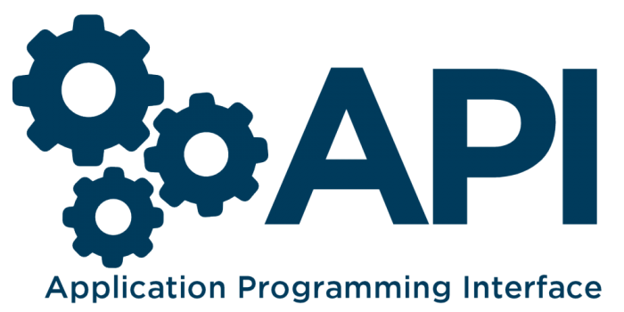

Future State MuleSoft Platform Architecture
Cloud to Cloud
Other Cloud Systems
API Consumers
Connectors & Rest APIs
Rest APIs
External Apps
Connectors
Integration & Rest APIs
Connectors
Partners
MuleSoft GovCloud
Platform
Cloud Runtimes
API Catalog
Control Plane
Ground to Cloud
Control Plane Communication
Control Plane Communication
VA TIC Boundary
DIP - FISMA High
FISMA Moderate
GovCloud Runtime
SSO via SAML
GovCloud Runtime
REST
JDBC
sFTP
SOAP & Other Protocols
Access Management
(API Authentication & Authorization)
VAEC & AITC Backend Systems
Ground to Ground
Service Enabled
Corp DB
Service Enabled
Business App
Business App
Business App
Business App
REST, JDBC, SFTP, SOAP, etc.
Business App
Business App
REST, JDBC, SFTP, SOAP, etc.
‹#›
‹#›

Slide 28
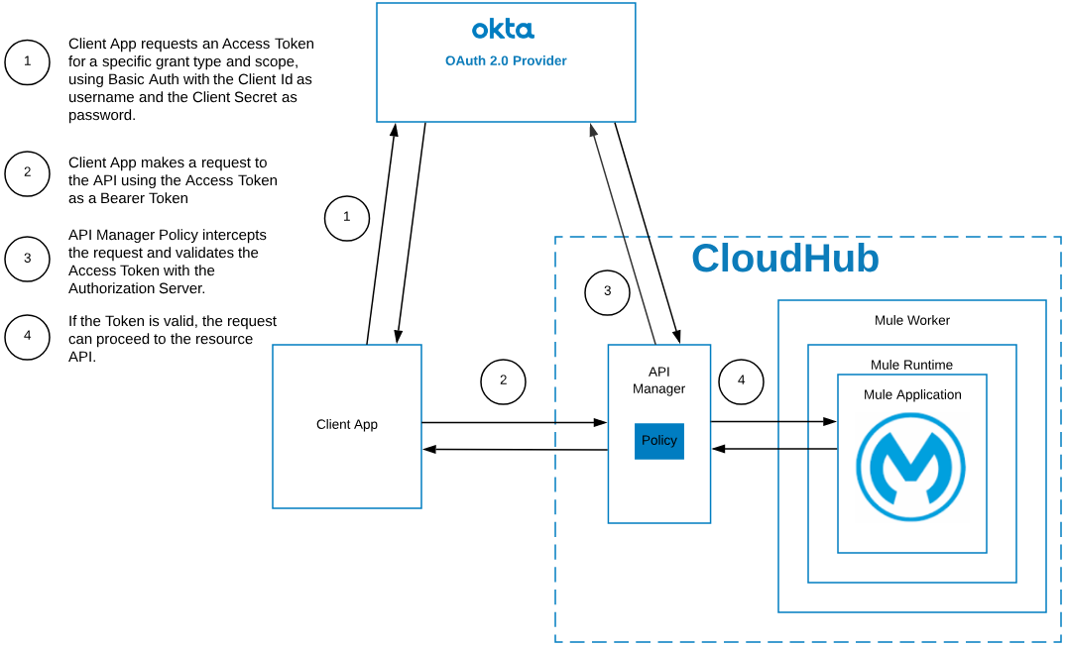
OAuth 2.0 Example Use Case

